Slide 1
Speed in CI/CD: Get Faster to Get Better
Dan Zentgraf, Director, Solutions Architecture - Liquibase

Slide 2

Today’s Presenter
Dan Zentgraf
Director, Solutions Architecture

Slide 3
What This Talk is About
Speed is Good
Acceleration is Better
Pushing to Get Faster Makes You Better

Slide 4
Speed is Good

Slide 5
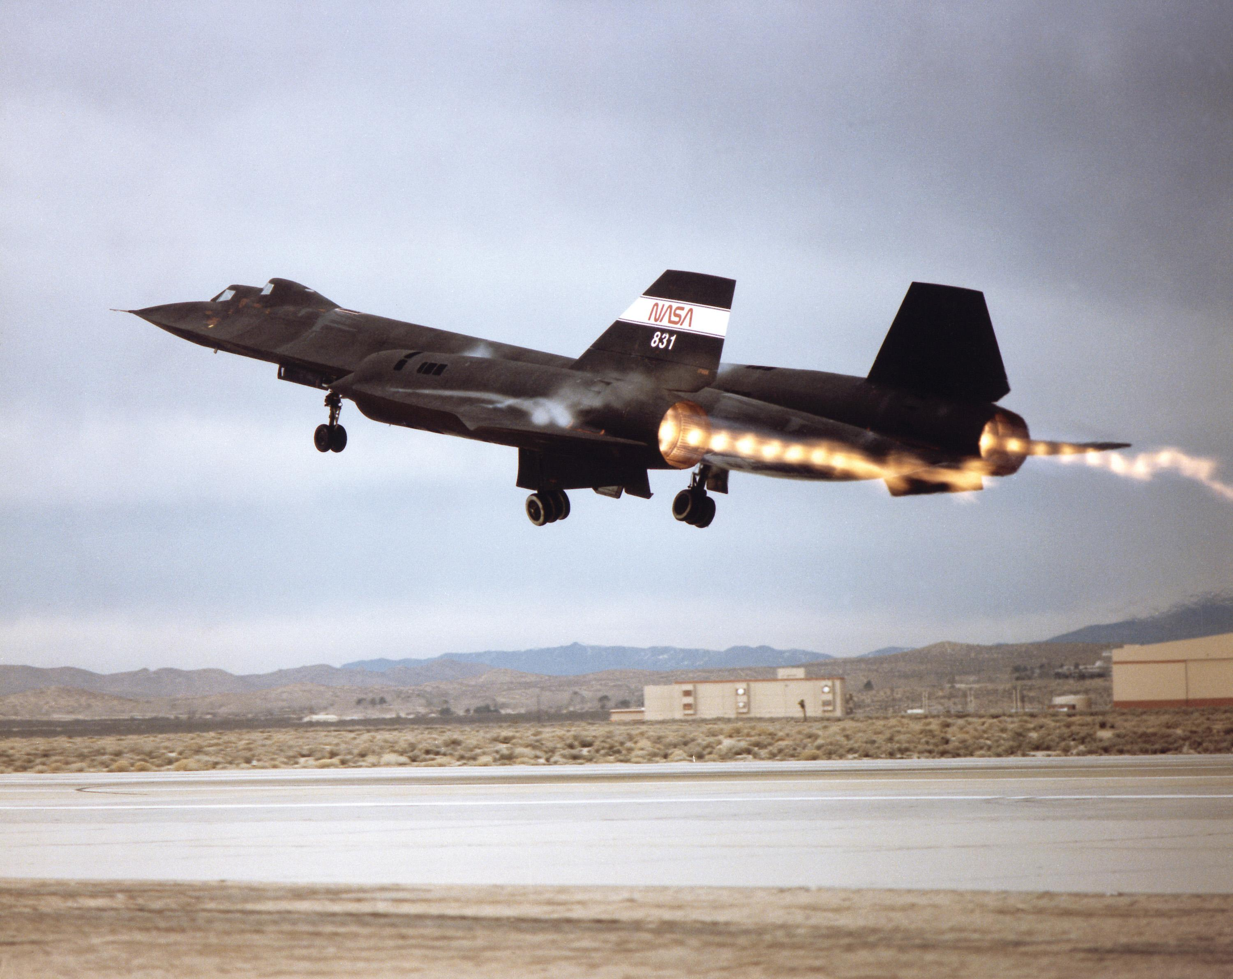



Fast Things Tend to Be More Awesome
Notes:
Soures:
ferrari.com
fiat.com
textron.com
nasa.gov

Slide 6
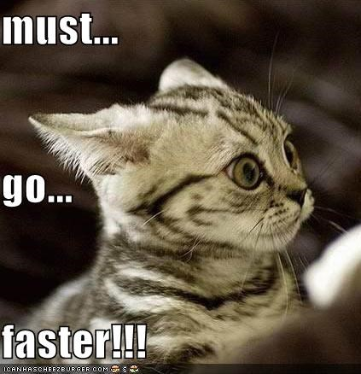

We Like Speed
We like taking less time to get places
We like getting things sooner
We hate waiting
We get frustrated when we are slowed by blocked work
We have tons of cultural sayings on the benefits of speed

Slide 7
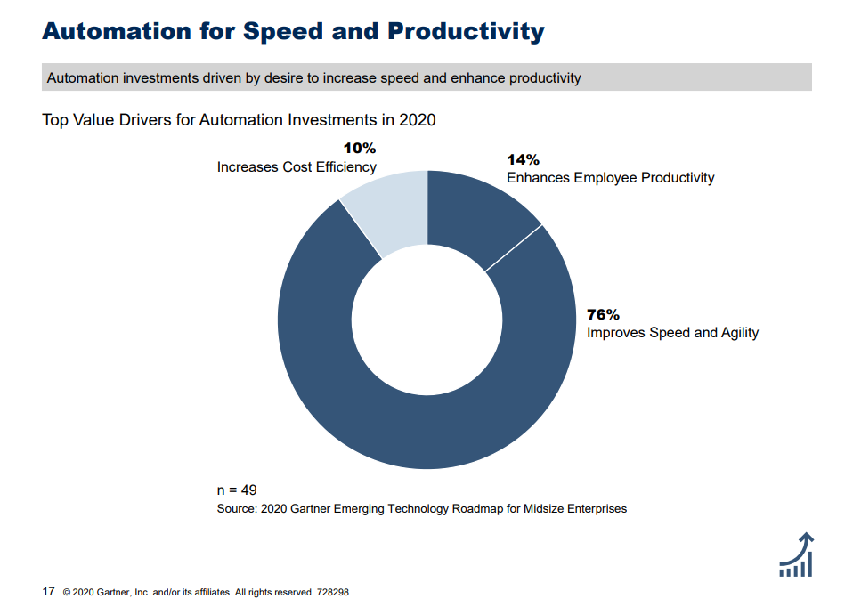
Business Uses Technology to Achieve Speed

Slide 8
- POLL - What do you think is the greatest benefit of CI/CD?
Increased speed of delivery
Shortened development cycle
Increased release frequency
Reduced complexity of dev lifecycle
Reduction in bugs post deployment

Slide 9
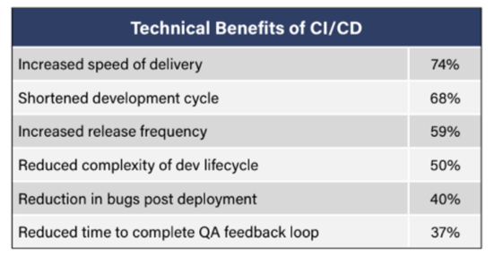
Key Benefits of CI/CD
Source: DZone Trend Report: The State of CI/CD: Evaluating Pipeline Maturity, September 2020

Slide 10
Acceleration is Better
The PURSUIT of more speed is better than just keeping speed you already have

Slide 11

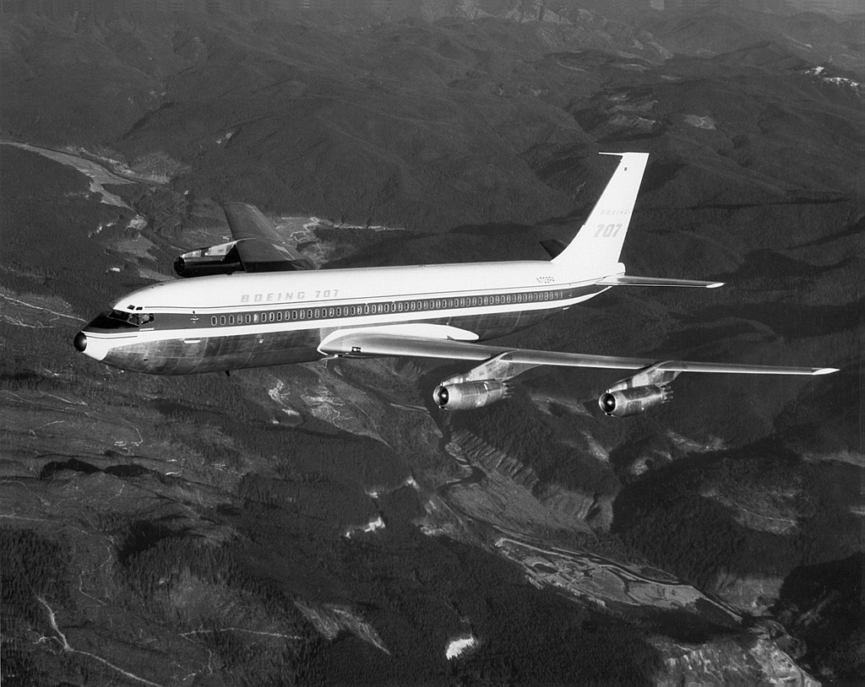
Race to Commercial Jet Aviation
1947 – Boeing 377
One of the last piston-engine propeller airliners
~60-100 passengers
Cruising Speed – 262 knots (201 mph)
Range ~3,600 nautical miles
1957 - Boeing 707
~189 passengers depending on configuration and variant
Cruising speed of 525 knots (~604 mph)
Range ~3,200 - 4,800 nautical miles
Sources: https://simple.wikipedia.org/wiki/Boeing_377, https://en.wikipedia.org/wiki/Boeing_707
Notes:
First commercially successful jet
Capped a ~10 year race to get there
Non-stop transatlantic range
So fast as to create the “Jet Set” concept

Slide 12
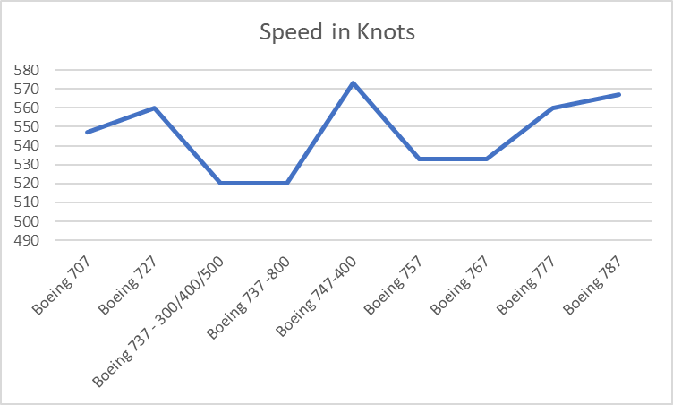
Commercial Jet Aviation 60+ Years Later

Slide 13

You Can Always Find a Way to Pursue Speed
If planes are what they are, how do you accelerate if you are an airline?
Boring plane –all 737s (first versions in 1966)
Agility
Standardized plane
Move crew around quickly
Ability to swap planes on routes
Simplified maintenance
Faster, simplified boarding
Only consistently profitable major US carrier for 47 years running
(as of end of 2019)
Notes:
Simplify - Remove Complexity
Add Lightness - Remove the Unnecessary
Automate - Remove Inconsistency
Monitor and Measure
Analyze Trends Over Time
Precise Control
Uninterrupted Flow - Eliminate Rework

Slide 14
Pushing to Get Faster Makes You Better

Slide 15

Speed Provides a Vision and Goal

Slide 16
The Other CI – Continuous Improvement
Continuous
Improvement
Plan
Do
Check
Act
Intrinsic to Agile / DevOps
Achieve better results without backsliding elsewhere
Improved Throughput
Improved Quality

Slide 17
You Must Actually Fix Things
Simplify - Remove Complexity
Add Lightness - Remove the Unnecessary
Automate - Remove Inconsistency
Monitor and Measure
Analyze Trends Over Time
Precise Control
Uninterrupted Flow - Eliminate Rework
Notes:
Pushing for speed means you must address
over-complicated situations
what is / is not necessary
enforce expectations and standards
pay attention to what is going on

Slide 18
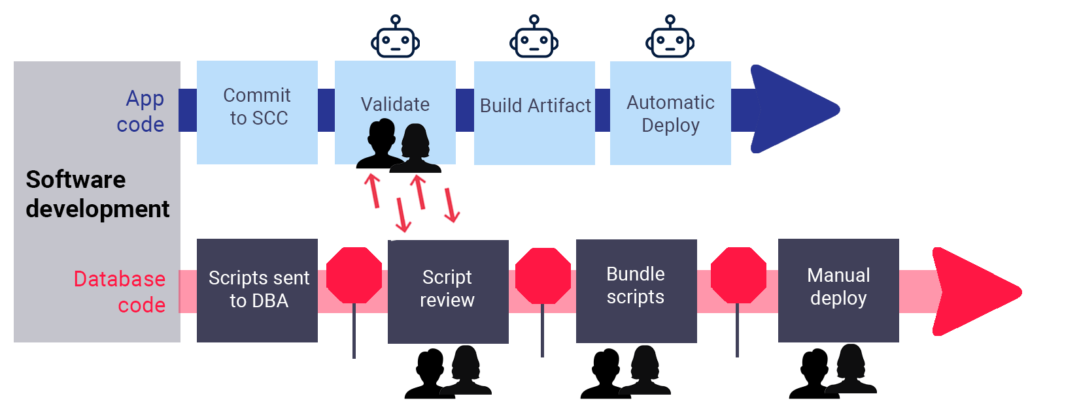
Simplify - Remove Complexity
Notes:
We see this pattern all the time
2 separate processes to deliver 2 parts of the same eventual stack
They are going to have to sync at some point
The more separate processes you have to deal with the harder it is to move faster
Spend time coordinating,
synching,
adjusting,
correcting

Slide 19
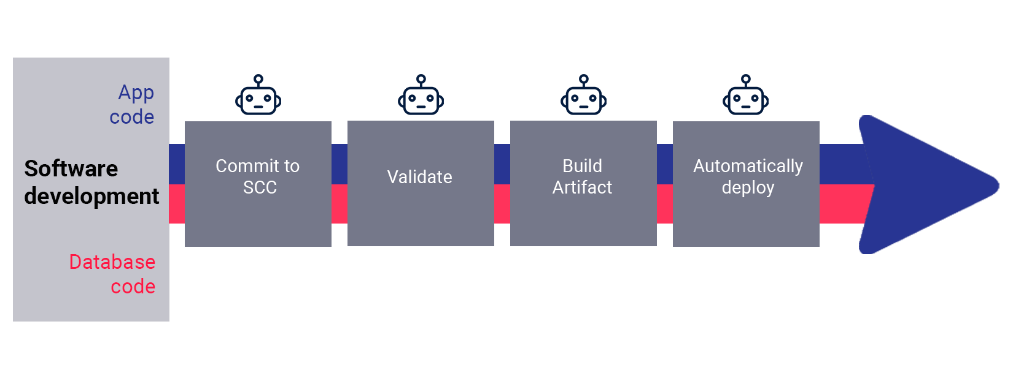
Simplify - Remove Complexity
Validate
Build Artifact
Automatically Deploy
Notes:
One process for everything
One workflow for all changes
Simple to learn / communicate
Simple to manage
Easy to unify information / truth
Easy to understand progress

Slide 20
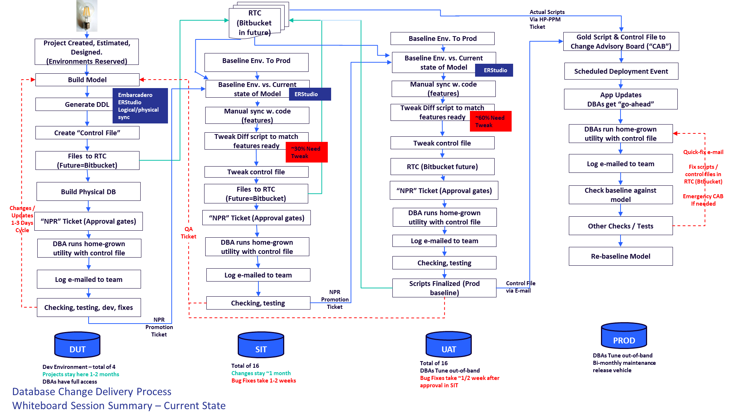
Add Lightness - Remove the Unnecessary
Notes:
It’s hard to go fast if you are heavy
Real world example of the point
This is that bottom process for DB changes at one company we worked with
Multiple communication channels
multiple ticketing systems,
Multiple sources of the truth
More handoffs for one database change than in an NFL game

Slide 21
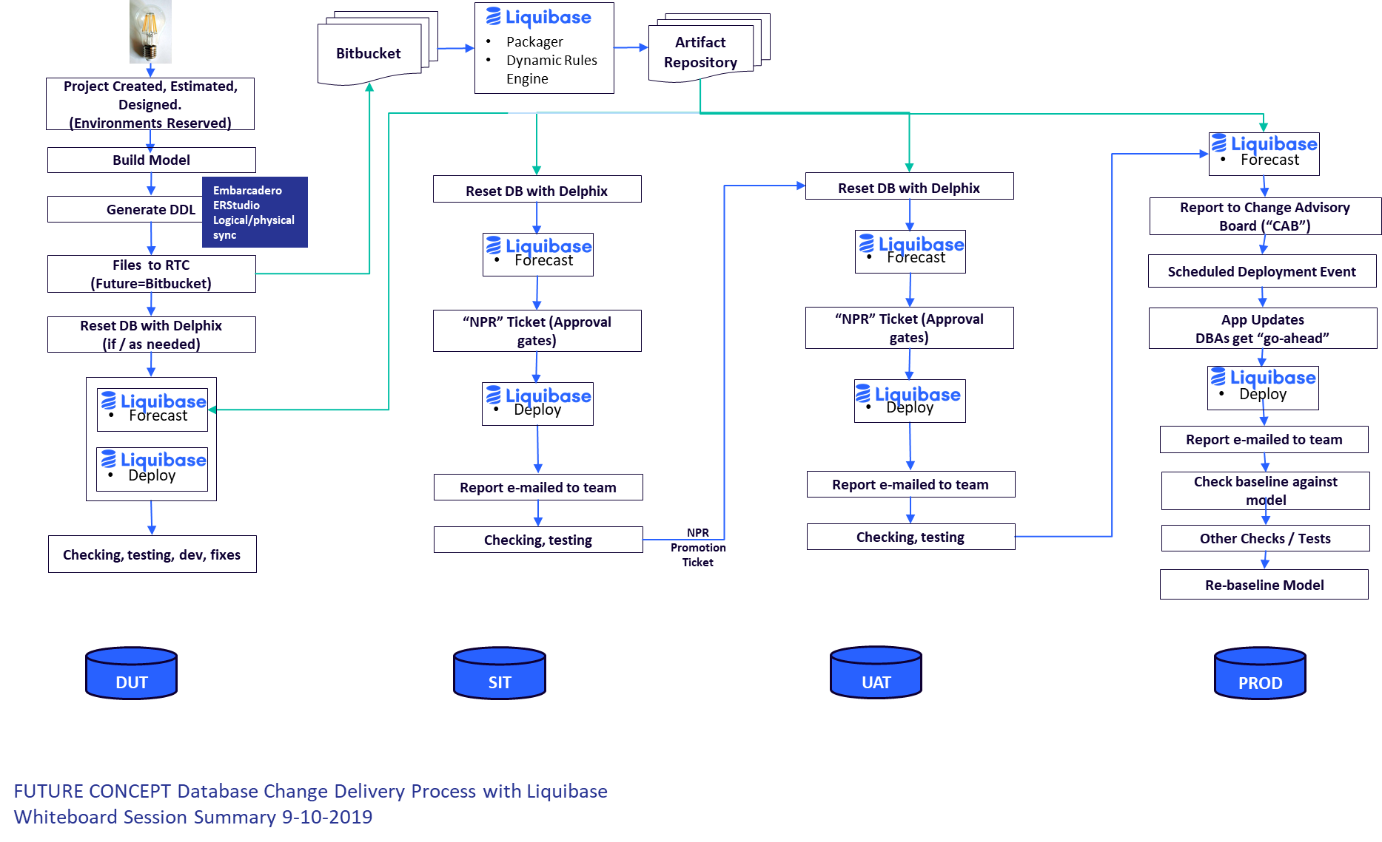
Add Lightness - Remove the Unnecessary
Notes:
Biggest thing was cleaning up communication paths
Switch to Build Once / Deploy Many approach
Old process had scripts going in/out of SCM
Scripts moving through ticketing system
– literally getting copied / pasted out of ticket into tool to deploy to PROD
We added some automation – will talk about what that means in a minute

Slide 22

Automate - Remove Inconsistency
Automation is the fastest way to go fast
Automation ensures predictable results
You can’t have automation if your process is inconsistent
Notes:
Inconsistency – you can’t automate an inconsistent or chaotic process
Too many exceptions, too many special cases will kill you
Forces you to standardize
Decide what is / is not acceptable as an input
Forces you to shift-left
Even partial automation exposes exactly how slow / inaccurate / inconsistent manual handling really is
by contrast
Garbage-in / Garbage-out translates to rework
Speed means you don’t have time for that

Slide 23















Automate - Remove Inconsistency
Database CI/CD
Develop / rework DDL, DML, database code
Commit to source code control
Call Liquibase Enterprise Packager
(CI Tool)
+
Get and store validated artifact
Deploy
(CD/ARA tool)
+
Pass?
Yes
DEV
TEST
PROD
No
Enterprise
Enterprise
Dev Sandbox
REF DB
Notes:
Automated flow
LB is a role player -> Automates the database piece of it

Slide 24
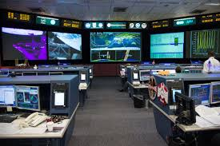
Monitor and Measure
Health
Impact of Improvements
Problems
Decision Support
Image: Johnson Space Center Mission Control, nasa.gov
Notes:
Things happen faster than humans can watch
Automated processes are very good at reporting what they are doing
Automated processes do not know if they are outside of expectations
You have to establish what ‘normal’ is
You have to see the effect of your improvements to see if they are working or need adjustment
You have to know when something is not working right
Must quickly decide

Slide 25
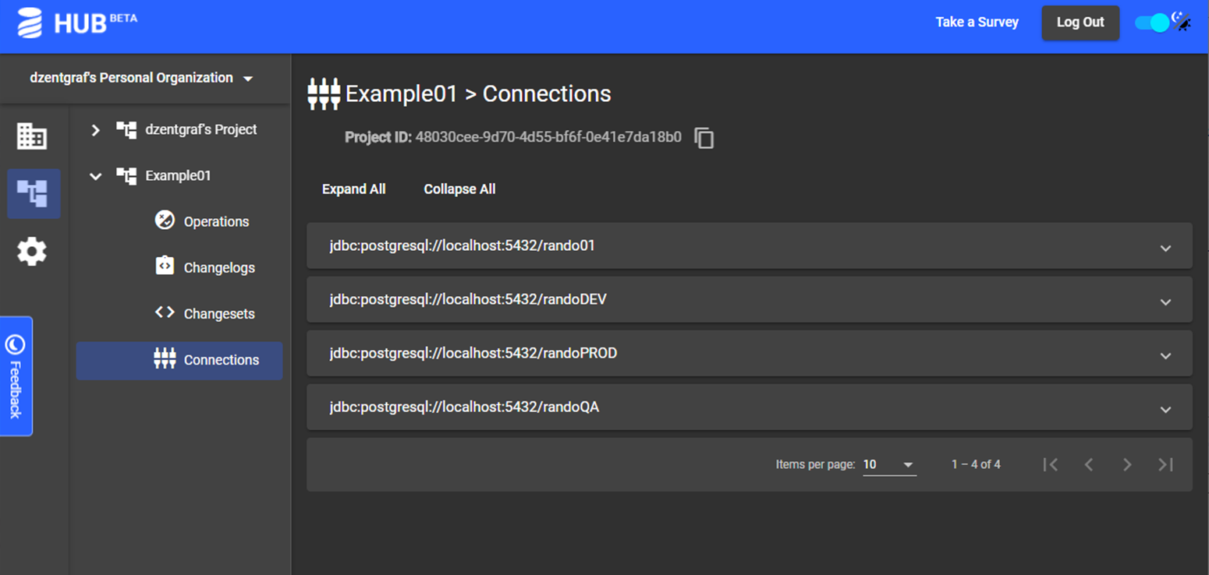
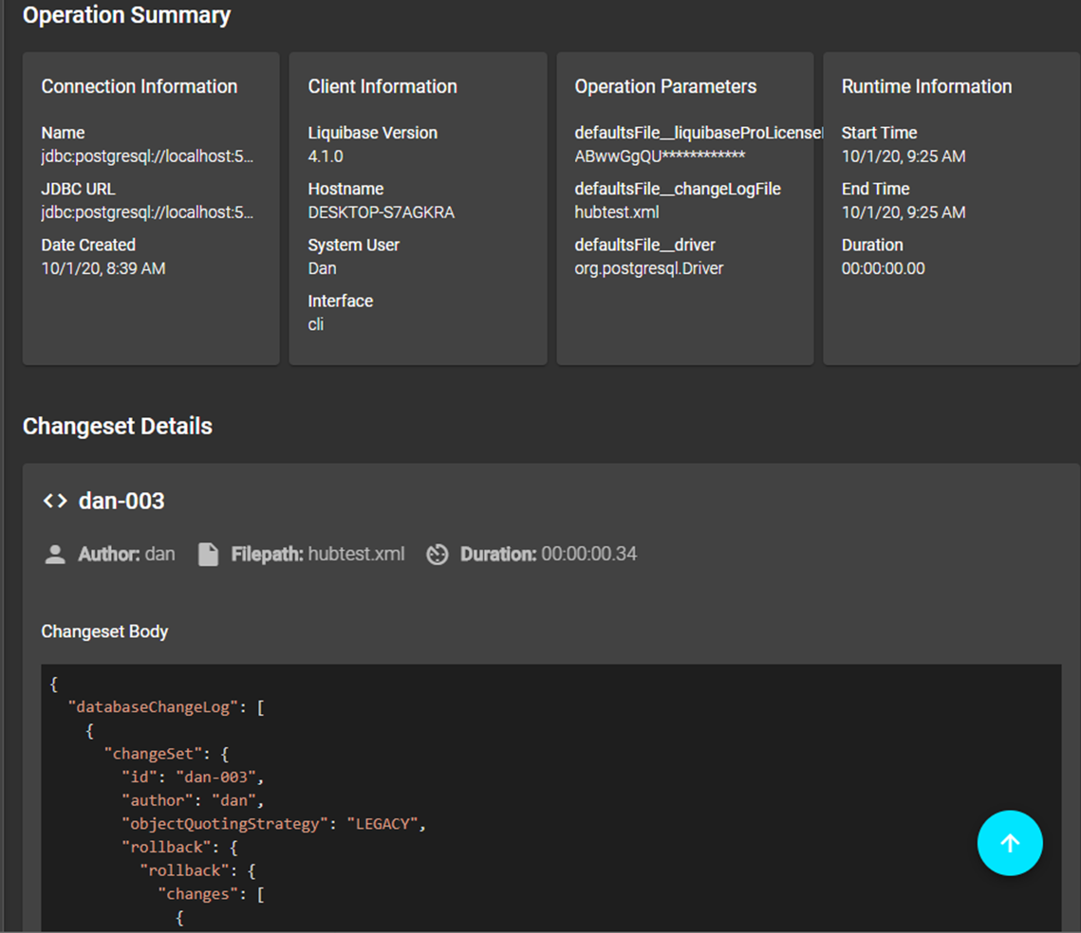
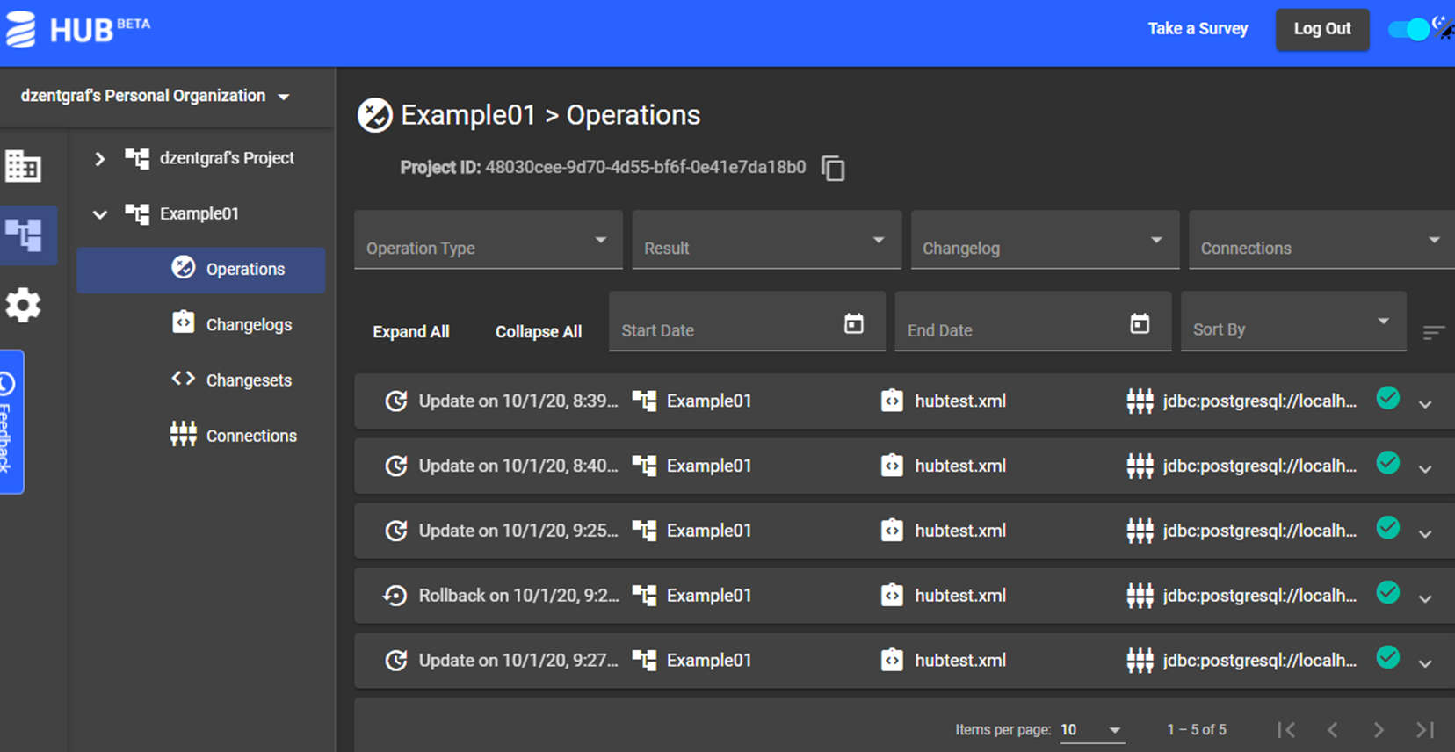
Monitor and Measure

Slide 26

Analyze Trends Over Time
Lead Time
Deployment Frequency
Change Fail Percentage
Mean Time to Restore
Notes:
They’ve done the research.
Just use it.

Slide 27
Analyze Trends Over Time
Averages from actual customer data using DORA KPI metrics¹.
Deployment Frequency
Lead Time Reduction
3x
95%
deployments/month
delays eliminated
Change Failure Rate
WIP Reduction
94%
66%
errors/month
changes/deployment
¹substituting WIP reduction for MTTR as recovery is not directly related to deployment performance.
Notes:
Frequency is 3 times more deployments / month
Change Failure rate is 94.26% of what it was
Lead Time Reduction is 94.13%
Batches are 40.24% the size of what they were reduced by 59.76%

Slide 28
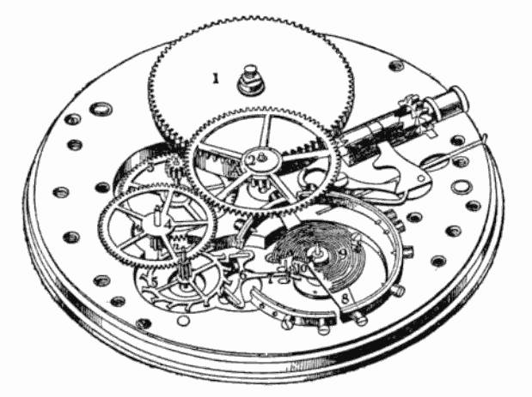
Precise Control
Ability to make very fine adjustments
Avoid large ‘swerves’
Small errors compound quickly at speed
Constantly adjust toward expected outcomes

Slide 29
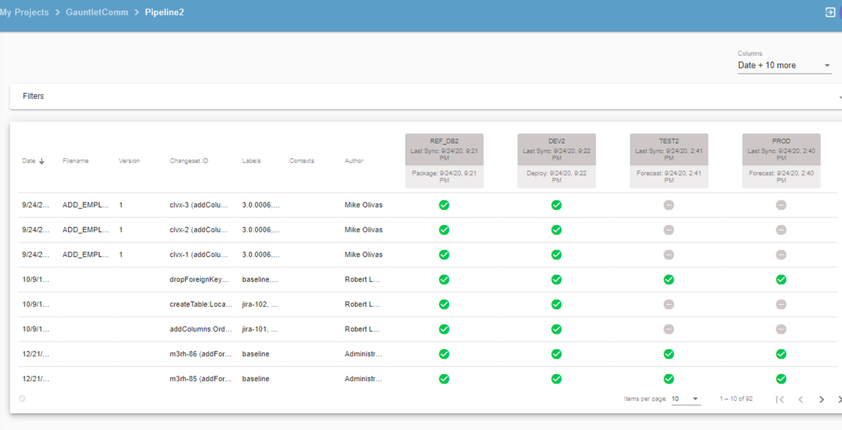
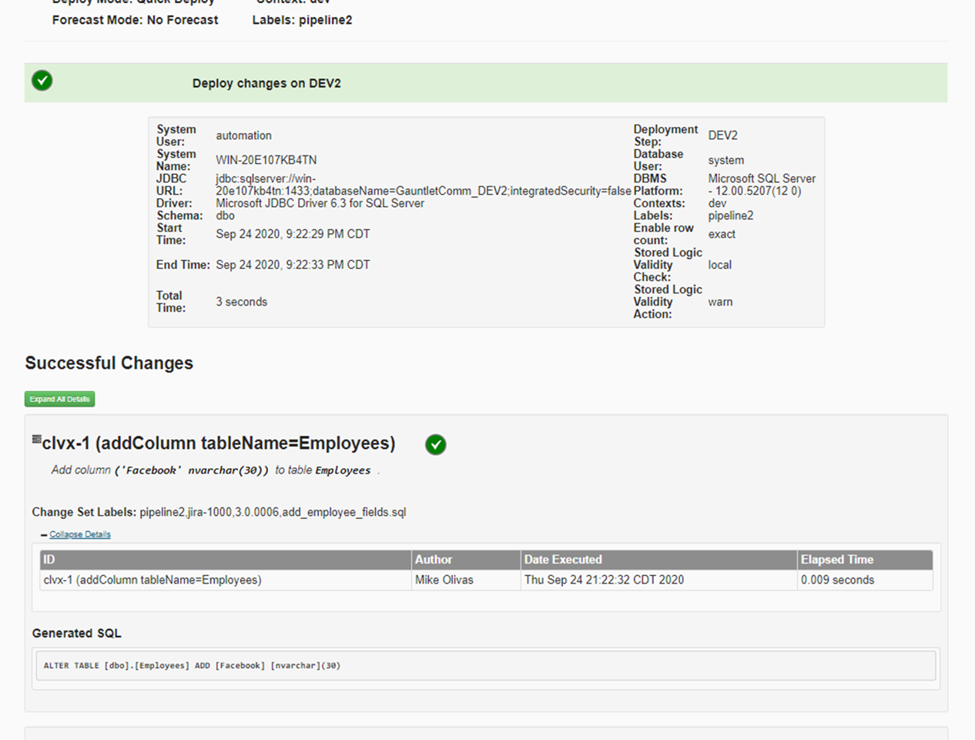
Precise Control
Notes:
Every piece of the pipeline has to provide visibility on all the individual pieces moving together to deliver the whole
Each piece getting where it is going
On time
The groups are moving together – no laggards
Everything needed for a release is where you expect it and moves when/where you expect

Slide 30

Uninterrupted Flow - Eliminate Rework
First Time Complete and Accurate
Build Quality In
Use the pipeline tools and capabilities you have built to ensure problems caught quickly
Avoid Flow Disruptions
Notes:
If you don’t have the resources to get it right the first time, why do you think you have the resources to do it twice?

Slide 31
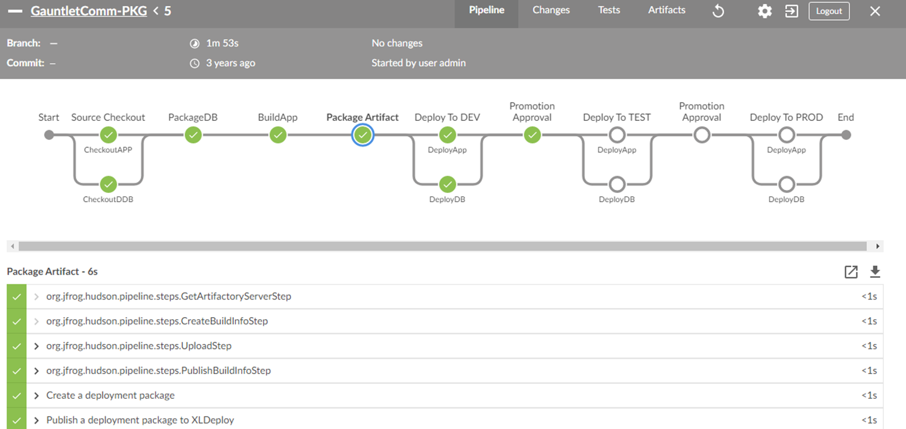
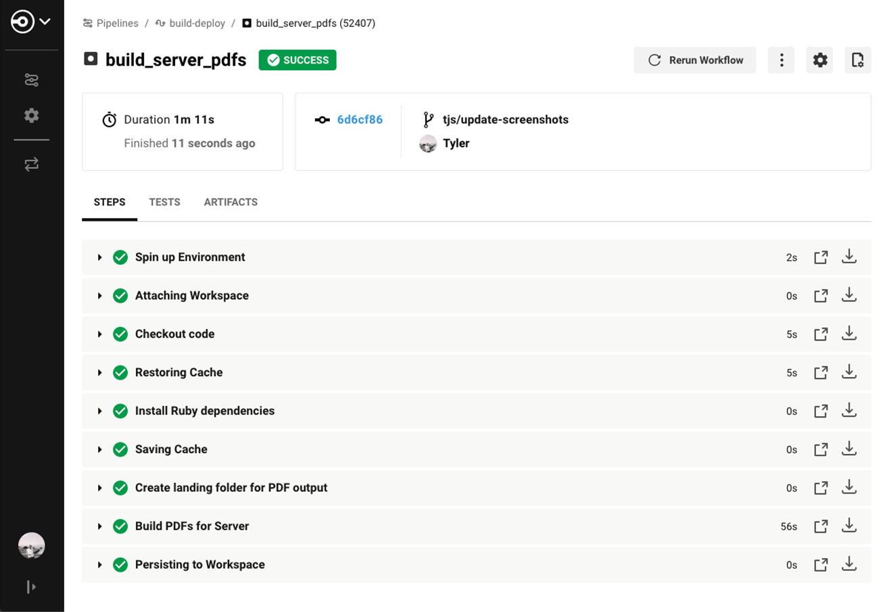
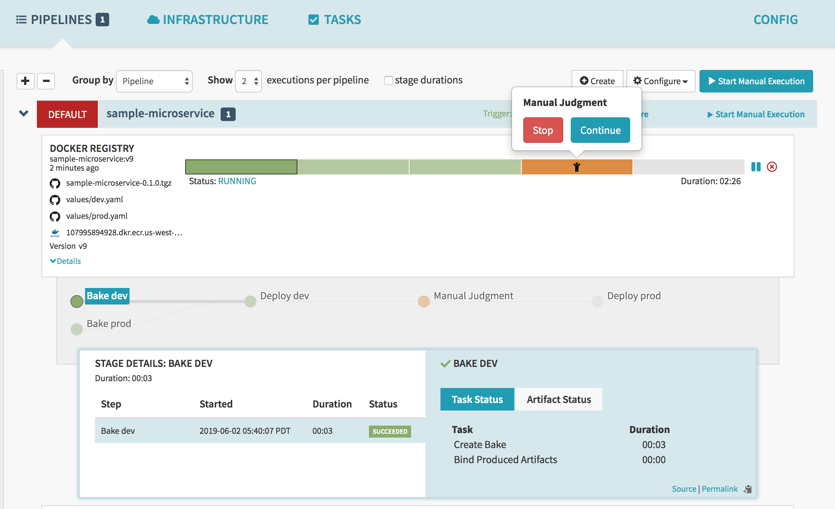
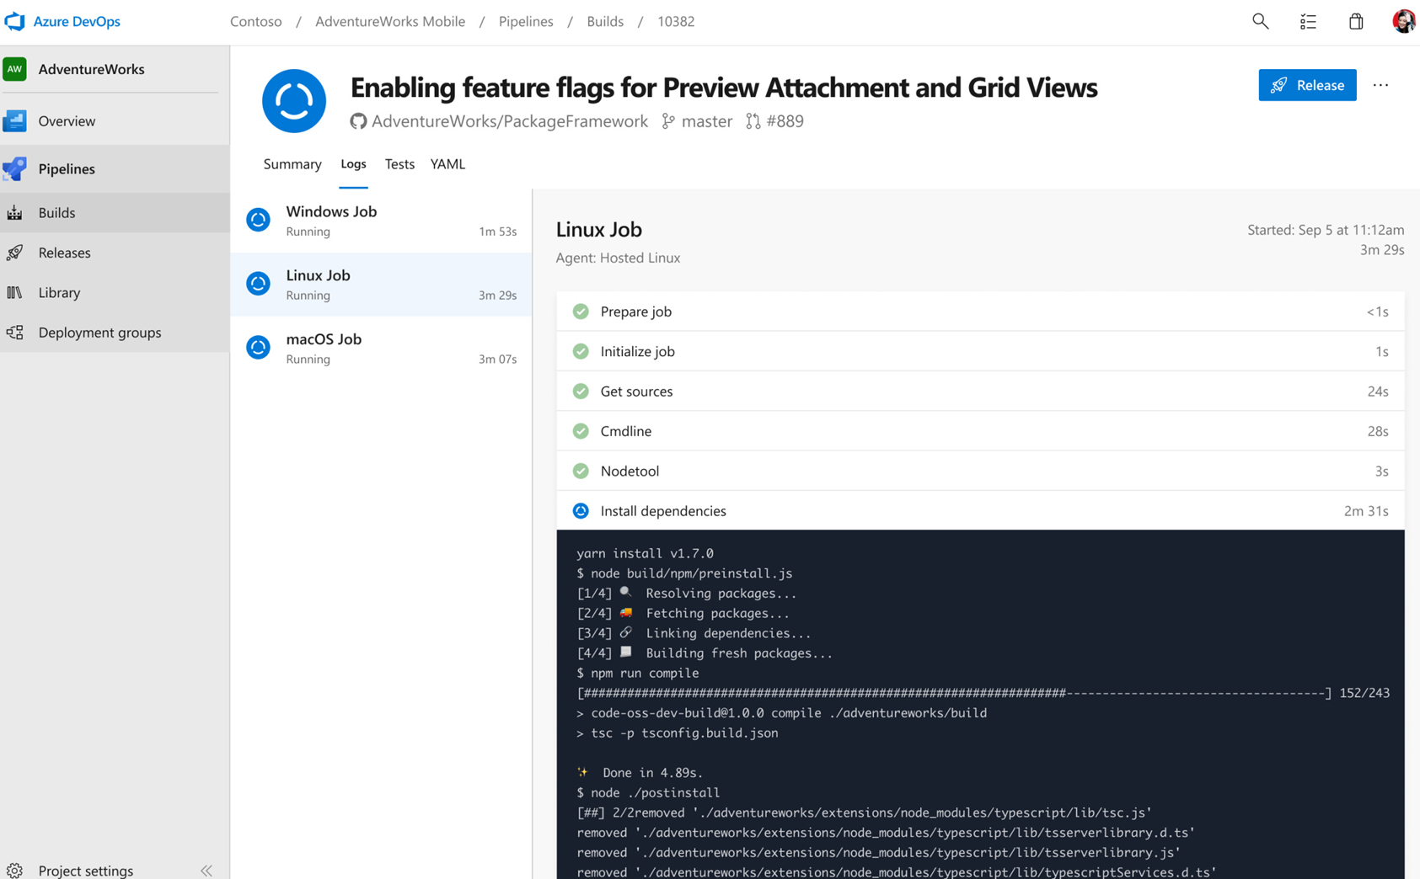
Uninterrupted Flow - Eliminate Rework

Slide 32
QUESTIONS

Slide 33
Be a Part of the Community!
www.liquibase.org
Official Liquibase Forum (forum.liquibase.org)
Stack Overflow (tag: Liquibase)
Discord Chat
Reddit: /r/Liquibase
Twitter: @Liquibase
Dan Zentgraf
Director, Solutions Architecture
dzentgraf@liquibase.com

Slide 34
See Liquibase in Action
See On-demand Demos: https://www.liquibase.com/demo
Learn about Liquibase Hub: https://www.liquibase.com/hub

Slide 35
THANK YOU

Slide 37
Speed in CI/CD: Get Faster to Get Better
Speed is central to discussions of the benefits of CI/CD. Too often, speed is presented as the goal of CI/CD. That’s not entirely true. Speed is exciting, but by itself, it is just expensive. Speed is valuable because of the things that it brings with it. In every instance where people pursue speed, they have to systematically simplify, lighten, and improve the thing they are trying to make fast.
This webinar will dive into what the pursuit of speed brings to DevOps and CI/CD so that you can break through the hype and truly improve your software process. It’s not about speed for the sake of speed; it’s about eliminating needless complexity and adding smart automation. Now that we’re living in a COVID world, more companies are focusing on speed and will leave those that aren’t far behind.
It’s not about being fast. It’s about getting faster

Slide 38
Punchline
All Agile and DevOps assume Continuous Improvement
Standing pat at a given speed yields stagnation
A prime driver of Improvement comes from pursuit of VELOCITY
That’s why the digital natives have pushed to the point where they can deploy in minutes or seconds

Slide 39
About Liquibase

